Slide 1
WHAT IS ZONTA
ADD YOUR VOICE TO EMPOWER WOMEN!
Notes:
Welcome! All of us today have at one time or another asked what is Zonta or answered the questions ourselves. For those of you new to the organization, you are about to get a short introduction and we hope you will ask all questions you might have.

Slide 2
IN THE BEGINNING
MARIAN de FOREST – ZONTA FOUNDER
Founded 8 November 1919, in Buffalo, New York, USA
Members were the FIRST generation of women to be college educated and have the right to vote in North America
Notes:
Six women, led by Marian de Forest, founded the first Zonta club in 1919 in Buffalo, New York. Within one month, 900 women chartered nine clubs in three states. They worked to improve the lives of women by decreasing restrictive labor laws, placing women in public office, and changing laws that discriminated against women.
[Share information about where your club fits into the history of ZI]
Extra information that could be used at the presenter’s discretion:
Marian de Forest was a journalist and playwright. While working in a prominent role at the Buffalo Express, during a time when women were rarely in leadership positions, Ms. de Forest conceived the idea of an organization that would bring together women in executive positions. She envisioned a strong network that would help women reach their rightful place in the professions. She understood how important it was to break through the "glass ceiling" long before the term was ever used.
On 8 November 1919, Ms. de Forest gathered a group of like-minded women who held prominent roles in the professional world at the Hotel Statler in Buffalo to form the Zonta Club of Buffalo. Zonta was founded as, and continues to be, a service organization of executive women working to improve the legal, political, economic and professional status of women worldwide.
Some fantastic and passionate quotes from Marian de Forest:
“Far reaching is our plan to assemble in Zonta International the women executives in the world, an army of experts who through friendship, understanding, cooperation and goodwill, will become
an irresistible force of peace.”
” This is the woman’s age and in distant lands and foreign climes women of all nations are rallying to the call ... Zonta is given the opportunity of uniting them into one great, glorious whole.”
”Zonta stands for the highest standards in the business and professional world … seeks cooperation rather than competition and considers the Golden Rule not only good ethics but good business.”
All quotes that are valid even now, nearly 100 years later

Slide 3
ZONTA’S MISSION
A leading global organization of professionals empowering women worldwide through service and advocacy
Notes:
Today, approximately 30,000 women and men are members in one of nearly 1,200 Zonta clubs found in 66 countries.

Slide 4
GENDER EQUALITY
EMPOWERMENT
ACCESS TO ALL RESOURCES
A LIFE FREE OF VIOLENCE
Notes:
Gender Equality – Women’s rights are recognized as human rights.
Empowerment – Every woman is able to achieve her full potential.
Access to all resources – Women have access to all resources and are represented in decision-making positions on an equal basis with men.
A life free of violence – No woman lives in fear of violence.

Slide 5
ZONTA’S VALUES
Zonta International is an independent, nonpartisan and nonsectarian global network of professionals united through purpose, which takes positions based on democratic principles

Slide 6
THE ZONTA EMBLEM
INSPIRATION
LOYALTY
CARRY TOGETHER
SHELTER
HONESTY AND TRUSTWORTHY
Notes:
Zonta is derived from a Lakhota, language of the Native American Sioux peoples, word meaning honest and trustworthy. It was adopted in 1919 to symbolize the qualities of honesty and trust, inspiration, and the ability to work together for service and world understanding. The emblem is not a decorative design. It is an adaptation and composite of several Sioux Indian symbols which when superimposed take on a special significance for Zontians. What appears to be the letter “Z” is actually the symbol for a ray of light or sunshine, thus the idea of inspiration.
Mahogany and gold, symbolizing the autumn season of Zonta’s founding, are the organization’s official colors.

Slide 7
ZONTA’S SYMBOL
Zonta’s symbol of friendship
Notes:
The yellow rose has been a symbol of Zonta for more than 30 years. In fact, it is registered internationally. Every year, Zontians celebrate Zonta Rose Day on March 8th, which is also International Women’s Day. Members around the world celebrate this day in a variety of ways, including giving yellow roses to individuals as a thank you for empowering women and girls in their communities.

Slide 8
ZONTA’S INTERNATIONAL BEGINNINGS
First international project assisted orphaned women and girls in Smyrna, Turkey
First club outside of the US is chartered in Toronto, Canada
International is added to Zonta’s name as the first European club is chartered in Vienna, Austria
1923
1927
1930
Notes:
Since 1923, Zontians have worked locally and globally to empower women and girls.

Slide 9
ZONTA’S GOVERNANCE
Zonta International Board
Zonta International Headquarters
Districts
Areas
Clubs
SUSANNE VON BASSEWITZ, INTERNATIONAL PRESIDENT DÜSSELDORF II, GERMANY, DISTRICT 29
Notes:
The Zonta International Board is comprised of four officers and seven directors elected democratically during Zonta’s biennial convention. The Board determines policy and provides general oversight of the organization. Headquarters staff implement policy and provide support for leaders and members. There are 31 districts and one region in Zonta. Each district establishes its own areas in order to facilitate administrative functions. Each area is comprised of clubs whose members pursue Zonta’s mission and goals through service and advocacy.
All members may attend the international convention held every two years. Via their club delegates, members also have a say on the future direction of the organization.

Slide 10
DECISION-MAKING IN ZONTA
Zonta International follows democratic procedures and values the participation of its members in the decision-making process at all levels.

Slide 11
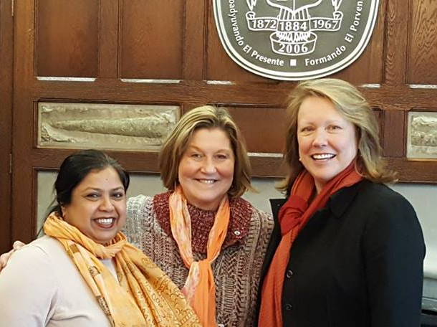
ZONTA EMPOWERS WOMEN
Participate in service projects that help women achieve their potential
Advocate Zonta’s position on women’s issues locally and internationally
Achieve greater impact internationally by combining our voices with like-minded organizations and the United Nations
Work with government and community leaders who share common goals
Notes:
“Zonta Says NO to Violence Against Women” is a Zonta International campaign to raise awareness of and increase actions to end violence against women and girls around the world.
The campaign, which began in November 2012, features the service and advocacy actions of Zonta clubs and districts to prevent and end violence against women and girls in their local communities. Since its inception, the campaign has garnered strong support from Zontians and non-Zontians alike.
In 2014, more impact oriented advocacy actions were undertaken. This biennium, we are focusing on more local and national government and community commitment.
[Insert information about club projects and activities.]

Slide 12
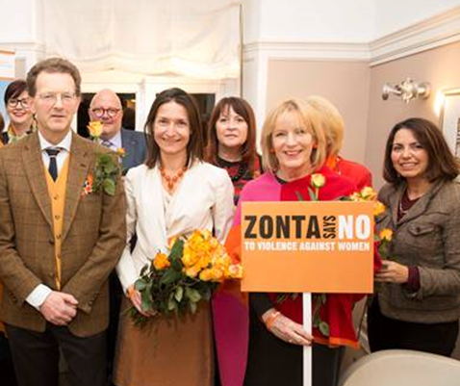
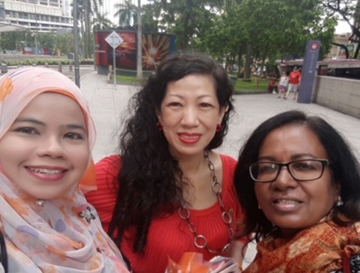
ZONTA EMPOWERS YOU
MEMBERS
Unite with other members in world fellowship
Connect with professionals globally who share the same passion to empower women
Receive mentoring and leadership development organized at the local and international levels
Discuss viewpoints and exchange ideas
Grow as a dynamic leader in organizing projects and activities
Notes:
Zontians are making a difference around the world. Our local and global projects and programs are positively impacting the lives of women and girls by improving their health, ensuring economic empowerment, providing educational opportunities, and working to end violence.
The photos in this slide are examples of some of these initiatives being done this biennium in Africa, Australia, Asia, Europe, New Zealand, and North/South America.
By respecting and acknowledging the diversity of our members, we continue to develop and implement life changing projects in our communities

Slide 13
WE FOCUS ON PROJECTS THAT MATTER
Advocacy
International Service Program
Zonta International Strategies to End Violence Against Women (ZISVAW)
Educational Programs and Awards

Slide 14
ZONTA HAS:
GENERAL CONSULTATIVE STATUS
UNITED NATIONS ECONOMIC AND SOCIAL COUNCIL (ECOSOC)
INTERNATIONAL LABOUR ORGANIZATION
PARTICIPATORY STATUS
COUNCIL OF EUROPE
Notes:
Zonta International has a long-standing relationship with the United Nations. We derive our relationship with the UN through the Economic and Social Council, ECOSOC, one of the 6 bodies of the UN.
We have been active with the UN since NGOs were first involved, in 1946.
Dating from these early days of the UN when NGO relationship was first established, and into the formal standing created in 1969, Zonta has worked hard with governments and the UN system on behalf of women.
When the Economic and Social Council revised its rules of work with NGOs in 1996, Zonta International qualified for the highest standing. Today we hold General Consultative Status, the highest ranking. Only 144 NGOs hold that status, out of more than 4500 NGOs in the 3 categories recognized today. (General, Special, Roster)
Zonta has been represented in the Council of Europe since 1983.

Slide 15
Z AND GOLDEN Z CLUBS
Help high school, college and university students develop leadership skills, promote career exploration and encourage members to participate in community, school and international service
Notes:
Zonta International believes that young people are critical to achieving gender equality and ending violence against women and girls around the world. To truly change the lives of women and girls globally now and for generations to come, we must invest in youth development and mentor young leaders for gender equality. Through the Z and Golden Z Club program, Zontians work to bring Zonta International’s mission to empower women through service and advocacy to students around the world and to stimulate new and meaningful student-led service and advocacy projects.
Z clubs are formed on secondary school campuses or in communities, and Golden Z clubs are formed on college and university campuses. These student clubs are designed to provide opportunities for young adults to develop communication and leadership skills, explore career alternatives, and increase their international awareness and understanding through service. Zonta clubs sponsor Z and Golden Z clubs, and provide students with the resources, information and guidance they need to improve the world around them. Z and Golden Z club students then plan, organize and participate in unique activities that give them hands-on experiences in improving the lives of others at both a local and international level.
The Emma L. Conlon Service Award recognizes those clubs that have best expressed the ideals of Zonta through their service and advocacy projects.
[Share information about any Z and/or Golden Z clubs your Zonta club sponsors.]

Slide 16
ADVOCACY
Members also take local advocacy action in their communities
Notes:
[What advocacy actions has your club taken?]

Slide 17
ZONTA INTERNATIONAL FOUNDATION
Through donations to the Zonta International Foundation, Zonta improves women's lives, their children's lives and the communities in which they live and work.
Notes:
The Zonta International Foundation is Zonta’s charitable arm that raises, invests, and distributes funds.

Slide 18
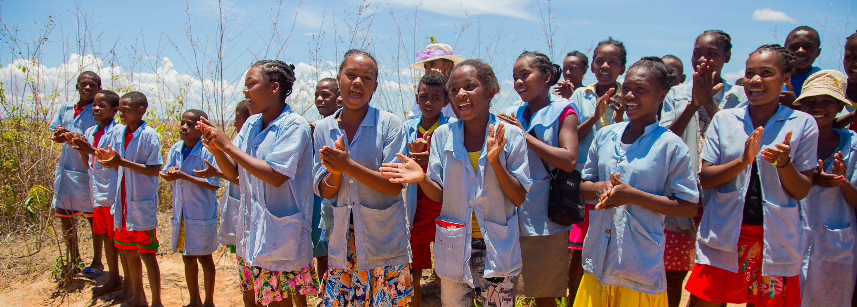
ZONTA INTERNATIONAL FOUNDATION FUNDING
ZONTA MEMBERS — ZONTA CLUBS — FRIENDS OF ZONTA
Funds the charitable and education programs of Zonta International.
Contributions go entirely to program support and development.
Zonta International membership dues support operating expenses.
Clubs are requested to give 1/3 of funds raised to the Zonta International Foundation
Notes:
Donations are also received from Friends of Zonta, individuals who are not able to join a club at present, but are passionate about empowering women and girls.

Slide 19
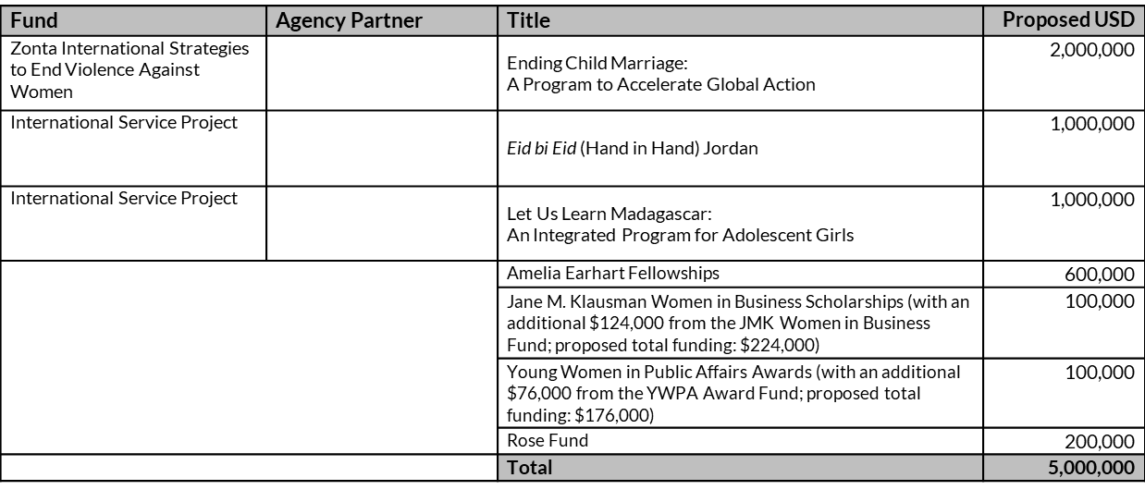
2018-2020 Fundraising Goal
Fundraising Goal = US$5,000,000
Notes:
The projects and programs, along with the proposed dollar goals seen here were approved by members during our international convention in 2016. As a non-governmental organization at the UN since 1946, Zonta International partners with UN agencies, such as UNFPA, UNICEF, and UN Women to achieve our projects’ goals.

Slide 20
INTERNATIONAL SERVICE PROGRAM
Let Us Learn Madagascar: An Integrated Program for Adolescent Girls
Eid bi Eid (Hand in Hand): Support for the resilience and empowerment of Syrian refugee and vulnerable Jordanian women
Notes:
Since 1923, more than $21 million dollars (US) has funded International Service Programs and Zonta International Strategies for the Elimination of Violence against Women, also known as ZISVAW, Projects benefitting women and girls in 36 countries.
Since 2008 Zonta International has been a major funder of the Liberia Fistula project together with UNFPA. We have so far donated 2,6 million USD and promised another 1 million USD this biennium. In 87% of the cases Obstetric fistula is caused by prolonged labor, without medical care. The baby is usually stillborn and the mother suffers from chronic incontinence. Still the pain and discomfort are easier to overcome than the stigma and humiliation attached to their condition. The project stands on 4 pillars. Prevent – treat- rehabilitate and support.
About 90 percent of Madagascar’s population lives on less than US$2 per day, leaving children particularly vulnerable. Aside from endemic poverty, Madagascar is prone to natural disasters, which further impede economic growth of the agricultural economy and make it even more difficult to escape poverty and prioritize education for children. More than a quarter of Madagascar’s children are excluded from formal education, and one out of three girls will become pregnant before the age of 18. Junior secondary school enrollment fees are prohibitively expensive for families, forcing parents to select one child to continue their education, often leaving girls behind. Zonta International has committed US$1,000,000 to the U.S. Fund for UNICEF to create opportunities for vulnerable and excluded girls to realize their rights to an education in a secure and protective environment. Partnering with the Ministry of National Education and others, Let Us Learn Madagascar will promote a common vision of investing in junior secondary education for girls as an entry point for equity

Slide 21
ZISVAW
ZONTA INTERNATIONAL STRATEGIES to end VIOLENCE AGAINST WOMEN
Ending Child Marriage: A Programme to Accelerate Global Action
Notes:
Early marriage is a form of sexual and gender-based violence with detrimental physical, social and economic effects. Niger has the highest child marriage rate in the world with 77 percent of girls married by age 18 and 30 percent married by age 15. Forty-two percent of adolescent girls give birth before the age of 17. A high proportion of school-aged girls are not in school and 73 percent of adolescent girls, ages 15-19, cannot read or write. This project was initiated 2014 and will continue also this biennium. Zonta International donated US$1,000,000 to UNFPA last biennium and has now committed to pay another USD 1.000 000 this biennium to reduce early marriage and early pregnancy in a critical mass of communities in Niger.
Nepal has long been a country of origin for labor migration and trafficking in persons, particularly women and children, for the purposes of sexual, labor and other forms of exploitation. Trafficking often takes place as part of undocumented migration and is a serious violation of human rights. In the aftermath of the April and May 2015 earthquakes, Nepal faces a heightened risk of human trafficking and unsafe migration. Some of the districts most affected by the earthquakes are historically known for high rates of trafficking of women and children and may thus face elevated levels of human trafficking. Many of these districts also have higher than average rates of female external migration, as well as ones where large numbers of men have left for employment elsewhere, leaving behind female-headed households at economic and social disadvantage with limited protection. The Government of Nepal has made a commitment to combat human trafficking with a comprehensive approach that includes policy reform, enforcement and programs that meet the practical needs of women at risk and provides alternatives to unsafe migration. However, despite policies, plans and programs in place to counter trafficking and promote safe migration, there is a lack of synergy at the operational level. Zonta International has committed US$1,000,000 to UN Women to create sustainable foundations for addressing the connection between human trafficking and foreign labor migration of women and girls in Nepal.

Slide 22
EDUCATIONAL PROGRAMS AND AWARDS
Amelia Earhart Fellowship
Jane M. Klausman Women in Business Scholarship
Women in Technology Scholarship
Young Women in Public Affairs Award
Notes:
Zontians strongly support educational and leadership initiatives for all women and girls. We need to support girls that want to pursue an education in the so called STEM fields Science, Technology, Engineering and Math or young women that want leadership positions. This is an investment for a future with more women in decision-making positions and more female role models.
The Amelia Earhart Fellowship assists women pursuing PhD degrees in aerospace-related sciences and engineering. It honors aviatrix Amelia Earhart, who was a member of the Zonta Club of New York.
The Jane M. Klausman Women in Business Scholarship assists women pursuing an undergraduate or graduate degree in a business-related field.
The Young Women in Public Affairs Award assists young women between the ages of 16-19 who demonstrate leadership skills and a commitment to public service and civic causes.
[Talk about any recipients recognized by your club.]

Slide 23
WHY ZONTA?
Empower women around the globe
Envision a world in which women’s rights are recognized as human rights and every woman is able to achieve her full potential
Share your commitment to empower women to take ownership of their own lives
Notes:
Do you care about empowering women around the globe?
Do you envision a world in which women’s rights are recognized as human rights and every woman is able to achieve her full potential?
Do you want to be part of a global network of women and men who share your commitment to empowering women to take ownership of their own lives?

Slide 24
ZONTA MEMBERS
Support Zonta’s mission and vision
Attend meetings
Participate in club, area, and district activities
Pay annual dues
Are nonpartisan
Are nonsectarian
Respect fellow members

Slide 25
TOGETHER WE CAN ACCOMPLISH MORE!

Slide 26
THANK YOU!

