Slide 1
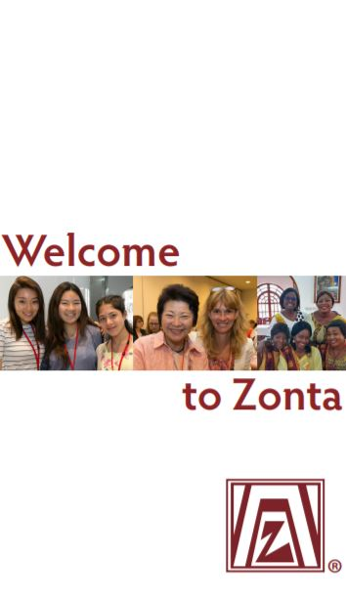
Club Member Orientation & Refresher
Notes:
Thank you for joining us today.
Please introduce yourself – name, club, length of time as a Zontian, and what you hope to get out of this program.
I will start – Mary Knight ZontaClub of Quaboag Valley in Western MA
I joined this club in the fall of 2000 and have served in many leadership positions.
My goal for this program is to share information and get ideas from participants on how our District can best meet their needs for engagement and leadership.

Slide 2
Overview
Historical perspective
Mission, Vision, Values, Causes
Core competencies for members
Be Actively Engaged
Get to Know Zonta (big picture)
Use Zonta Resources
Promote Advocacy and Service
Notes:
We will cover basic information about Zonta - so we are all on the same page about this organization.
Then we will review what Zonta calls ‘core competencies’ –
The women and men attracted to Zonta bring many skills and life experiences to the club and Zonta gives us the opportunity to continue to grow as leaders by developing a set of knowledge and skills that help us be effective in our specific and many Zonta roles.
Please be curious as proceed – this is a safe zone to ask any questions about Zonta! If I don’t have the answer, I will research it and get back to you.

Slide 3
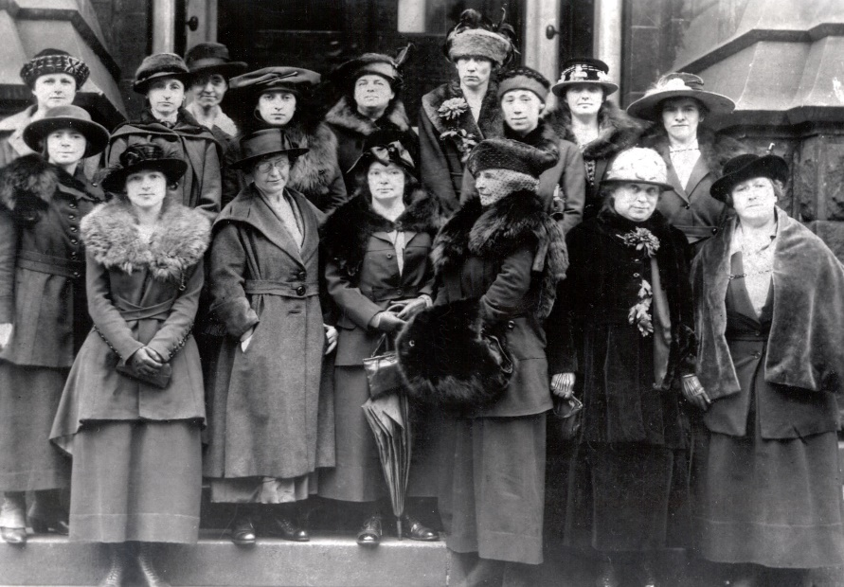
Historical Perspective
1919 — Zonta created to make a difference:
Women’s rights
Ethics in business
World peace
Notes:
In the early 1900’s women were entering the workforce but rarely held leadership positions and were purposely excluded from service organizations like Rotary.
A group of 5 business women in Buffalo NY, led by Marian deforest, conceived of the idea of a strong network of women in business positions who would work to take their rightful place in the professions next to men.
The idea spread rapidly and by November 8, 1919, nine clubs with 600 members drafted and adopted bylaws and a constitution. They chose the name Zonta – a word meaning honest and trustworthy, an emblem, and the colors of mahogany and gold. Their mission was to support women’s rights, promote ethics in business and work for world peace.
Zonta International was incorporated in the state of Illinois when the first European club was formed in Vienna Austria in 1930.;
(derived from the Lakhota language of the NativeAmerican Sioux peoples)

Slide 4
Then and Now
Members:
Believe in Zonta’s mission
Influence our society
Are change agents for a better world for women
Notes:
Like other women’s organizations, Zonta encourages teamwork, courage, risk-taking, and self-reliance. and it also represents leadership, decision-making and self-development.
Zontians are influencers and change agents

Slide 5
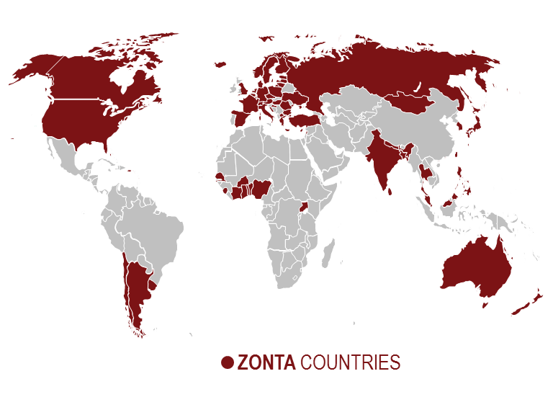
Mission
Zonta International is a leading global organization of professionals empowering women through service and advocacy.

Slide 6
Vision
Zonta International envisions a world in which women's rights are recognized as human rights and every woman is able to achieve her full potential.
In such a world, women have access to all resources and are represented in decision-making positions on an equal basis with men.
In such a world, no woman lives in fear of violence.

Slide 7
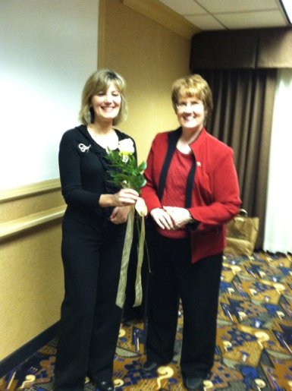
Core Values
Zonta International is an independent, nonpartisan and nonsectarian global network of professionals united through purpose, taking positions based on its own values and democratic principals.

Slide 8
Causes
We Empower Women
Notes:
The causes we work on locally and globally

Slide 9
Core Competencies for Members
Be actively engaged in the club
❷ Get to Know Zonta – the big picture
❸ Use Zonta Resources
❹ Help Promote Zonta Advocacy and Service

Slide 10
Be Actively Engaged in the Club
❶
Membership is the heart of our organization
We share skills, competencies and experience to ensure mission fulfillment and vision achievement.
Members are the public image of Zonta within the community

Slide 11
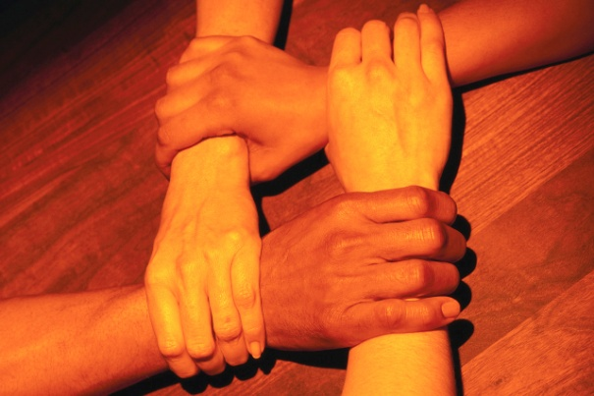
The Club
❶
The club is the basic organizational unit of Zonta. Members belong to clubs – not chapters. It is the club that is the voting power at the district and international levels. Clubs make decisions and elect leadership.

Slide 12
Purpose of Clubs
❶
Provide local and international service
To raise funds to support service projects
To educate, inform and advocate for women’s issues
To actively seek to increase Zonta membership
To share fellowship and network to support one another
To have fun
Examples?
Notes:
Purpose of Zonta Clubs:
Provide local and international service Look for synergy by partnering with organizations who are doing the work. Shelters, Task Forces, etc. What hands-on projects are needed? Where we can we add value?
To raise funds to support service projects Currently: Golf Tournament, Poinsettia Drive and May Calendar Lottery
To educate, inform and advocate for women’s issues Seek out opportunities in the community where we can speak, have an informational table, etc. Invite speakers who can enlighten us on shared vision and mission. How can we speak out for those whose voices are not being heard?
To actively seek to increase Zonta membership Strive for diversity and inclusion; listen and learn; be open to individuals who are different from us. Explore ways of reaching out – Meetup.com, Volunteermatch.com, LinkedIn, Education contacts, World Council members… Hand out our ‘business cards’ and invite supporters to join our cause.
To share fellowship and network to support one another Experienced members are expected to be a mentor; members seeking leadership roles in the club or district are encouraged to seek a mentor. Be there for each other.
To have fun How can we honor and appreciate one another and spread joy?

Slide 13
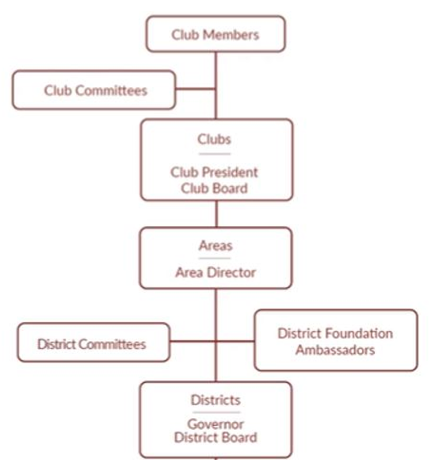
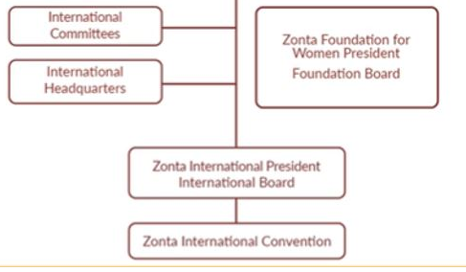
Get to Know Zonta: Structure
❷
Notes:
Z

Slide 14
Club Structure
❷
Leadership: Elected officers and directors = the Club board of directors
President, Vice President, Treasurer, Secretary, at least two directors
(Recommended term of office — two years to match Zonta International biennium)
Committees: Elected and required
Nominating, membership, service, advocacy, and others authorized by the club board

Slide 15
Zonta District 1 (31 other Districts)
❷
District 01 Clubs
Area 1 ~ Maine, NH & VT and Nova Scotia CA
Area 2 ~ MA, CT & RI
Leadership: Elected officers and directors = the District Board
Governor, Lt. Governor, treasurer, secretary, at least two directors
Committees mirror Club Structure
Notes:
Beatrice Schori Governor
Donna Sroka Lt. Governor
Kathryn Patterson Secretary
Terry Timmerman Treasurer
Mary A. Socha Parliamentarian
Vickie Palardy Area 2 Director
Carol Dobson Area 3 Director

Slide 16
International Structure
❷
Leadership: Elected officers and directors = the International Board
President, President-elect, Vice President, Treasurer/Secretary, seven Directors
International Committees: Elected and required
Nominating, membership, service, advocacy, and others authorized by the International board

Slide 17
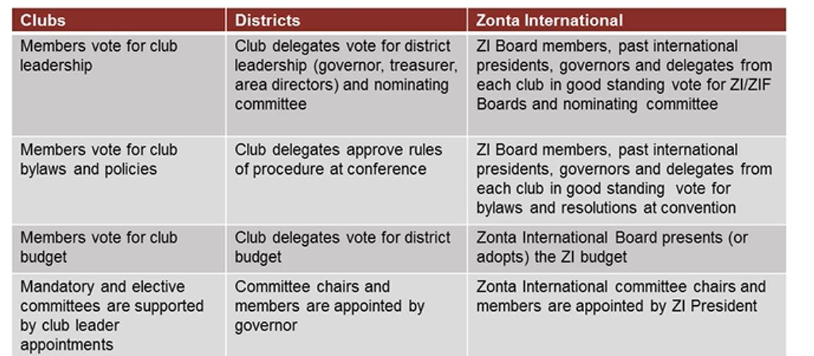
Leaders Serve Members
❷

Slide 18
Zonta Resources – ZI Public Website
❸
Zonta.org
Notes:
Z

Slide 19
Can you find…
❸
Info about Zonta’s global service projects
Description and form for JMK scholarship
Zonta videos
Members of the Zonta International Board
Where to donate to the Foundation for Women
Notes:
Whatever your role is in Zonta and regardless of how long you have been a member, questions come up about who to contact, what we are doing, where to find something, when an event is scheduled, or why we are doing what we do!

Slide 20
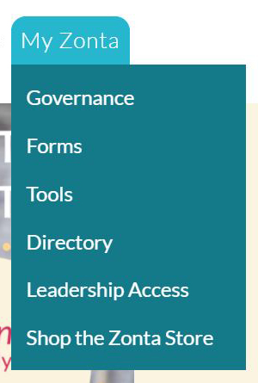
Zonta International’s Member Site
❸
www.Zonta.org My Zonta tab
On the member page are links to key information to support your membership, fundraising, service, advocacy and leadership initiatives.
Access to materials just for Zonta members
SIGN IN prompt:
Your personal email (on file with Zonta)
Your personal password
See also: ZontaDistrict1.org ~ Resource Center ~ Website Guidance Help in logging in and managing your Profile
Notes:
When you sign on for the first time – put in your email and when prompted for a password, click I FORGOT MY PASSWORD You will be able to set one up.

Slide 21
Can you find…
❸
Your membership # and personal data stored at ZI
The Zonta Club Manual
Zonta Leadership Program
Advocacy and Membership Tools
The Zonta Store
Notes:
Whatever your role is in Zonta and regardless of how long you have been a member, questions come up about who to contact, what we are doing, where to find something, when an event is scheduled, or why we are doing what we do!

Slide 22
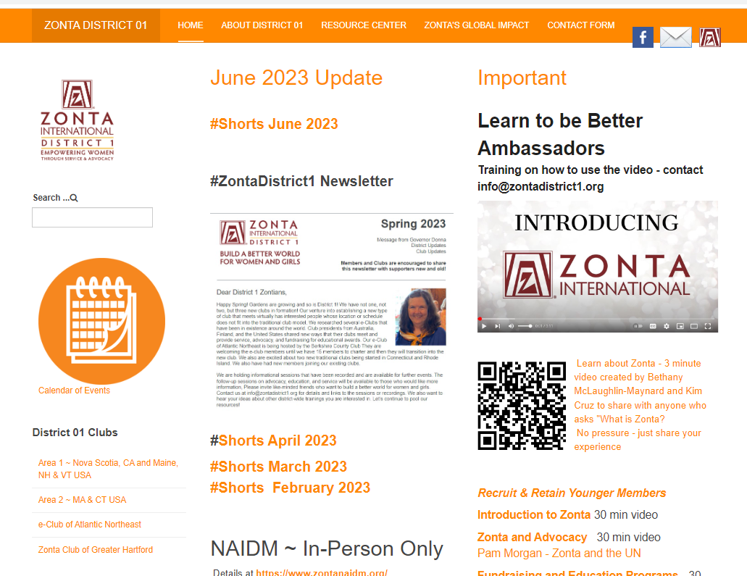
Zonta District 1 Website
❸
ZontaDistrict1.org

Slide 23
Can you find…
❸
The current District Newsletter
Info on the Clubs in Area 2
Past and Current Event info in the District
District Committee Chairmen
The District Resource Center
Notes:
Whatever your role is in Zonta and regardless of how long you have been a member, questions come up about who to contact, what we are doing, where to find something, when an event is scheduled, or why we are doing what we do!

Slide 24
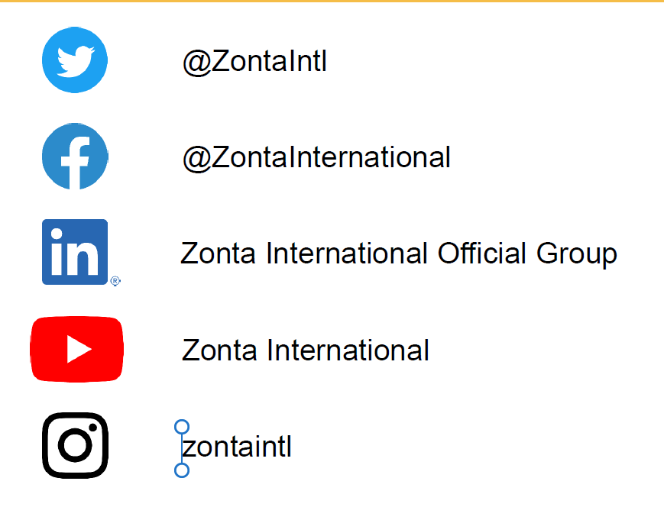
Other Zonta Resources
❸

Slide 25
Use Zonta Resources
❸

Slide 26
Promote Advocacy and Service projects
❹
Our Common Goal: Empowering women through service and advocacy by
Advocating for gender equality
Expanding access to education
Elevating women to decision-making positions
Ending gender-based violence

Slide 27
Promoting projects starts with you
❹
Membership is the heart of our organization
We share skills, competencies and experience to ensure mission fulfillment and vision achievement.
Members are the public image of Zonta within the community

Slide 28
Club Member Orientation & Refresher
Historical perspective
Mission, Vision, Values, Causes
Core competencies for members
Be Actively Engaged
Get to Know Zonta (big picture)
Use Zonta Resources
Promote Advocacy and Service
Notes:
We will cover basic information about Zonta - so we are all on the same page about this organization.
Then we will review what Zonta calls ‘core competencies’ –
The women and men attracted to Zonta bring many skills and life experiences to the club and Zonta gives us the opportunity to continue to grow as leaders by developing a set of knowledge and skills that help us be effective in our specific and many Zonta roles.
Please be curious as proceed – this is a safe zone to ask any questions about Zonta! If I don’t have the answer, I will research it and get back to you.

